Slide 1
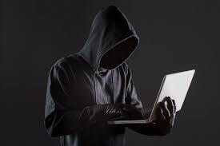
Title: Phishing Awareness Training
Subtitle: Maryam Noor

Slide 2
Professional Agenda:
Understanding Phishing Attacks (Intro to Phishing)
Mechanics of a Phishing Campaign (How Phishing Works)
Common Variants of Phishing (Types of Phishing)
Identifying Red Flags in Communication (Signs of a Phishing Attempt)
Case Study: Real-World Phishing Incident (Real-life Example)
Best Practices for Prevention (How to Protect Yourself)
Interactive Knowledge Check (Quick Quiz)
Key Takeaways & Action Points (Final takeaway)

Slide 3
Understanding Phishing Attacks:
Phishing is a deceptive cyberattack where criminals disguise themselves as trusted entities to steal sensitive information like passwords, credit card details, or personal data. It often comes through emails, text messages, or fake websites.

Slide 4
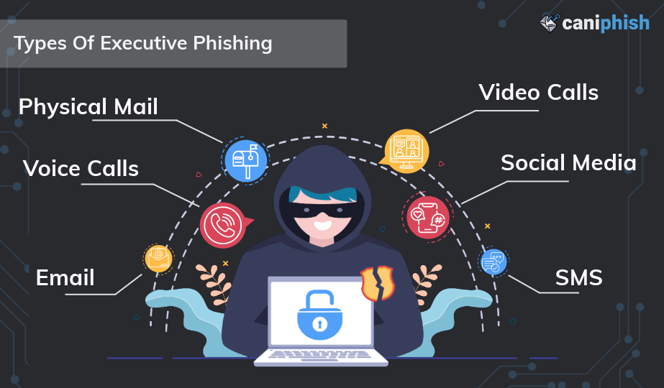
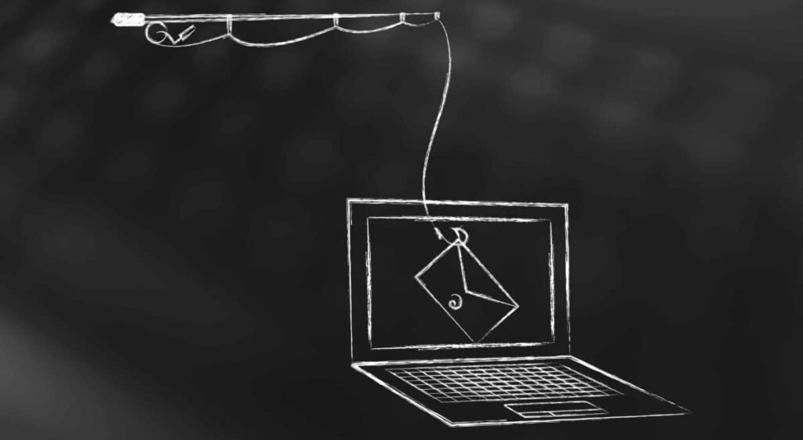
Mechanics of a Phishing Campaign
Plan – Gather information about the target.
Create – Design a fake email or message.
Send – Deliver the phishing content to the target.
Deceive – Trick the victim into clicking or submitting data.
Steal–Capture credentials or sensitive information.

Slide 5
Common Variants of Phishing:
Email Phishing
Fake emails pretending to be from banks, companies, or colleagues.
Spear Phishing
Targeted emails for specific individuals or organizations.
Smishing
Fake SMS messages with malicious links.
Vishing
Voice calls pretending to be from trusted entities.

Slide 6

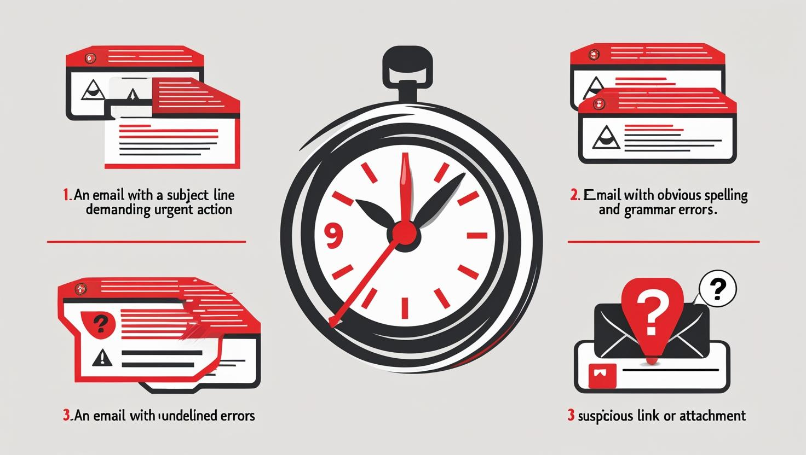
Identifying Red Flags:
Look for signs like.
1.Unexpected emails asking for urgent action.
2.Spelling or grammar mistakes.
3.Suspicious links or attachments.
4.Unknown senders or strange email addresses.

Slide 7
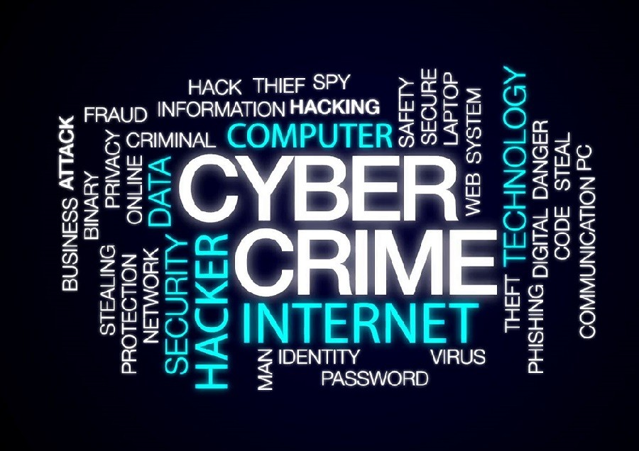
Real-World Case Study:
In 2022, a major company lost millions when an employee clicked on a fake invoice email. The attacker gained access to sensitive data and transferred funds before being detected. This shows how one click can cause massive damage.

Slide 8
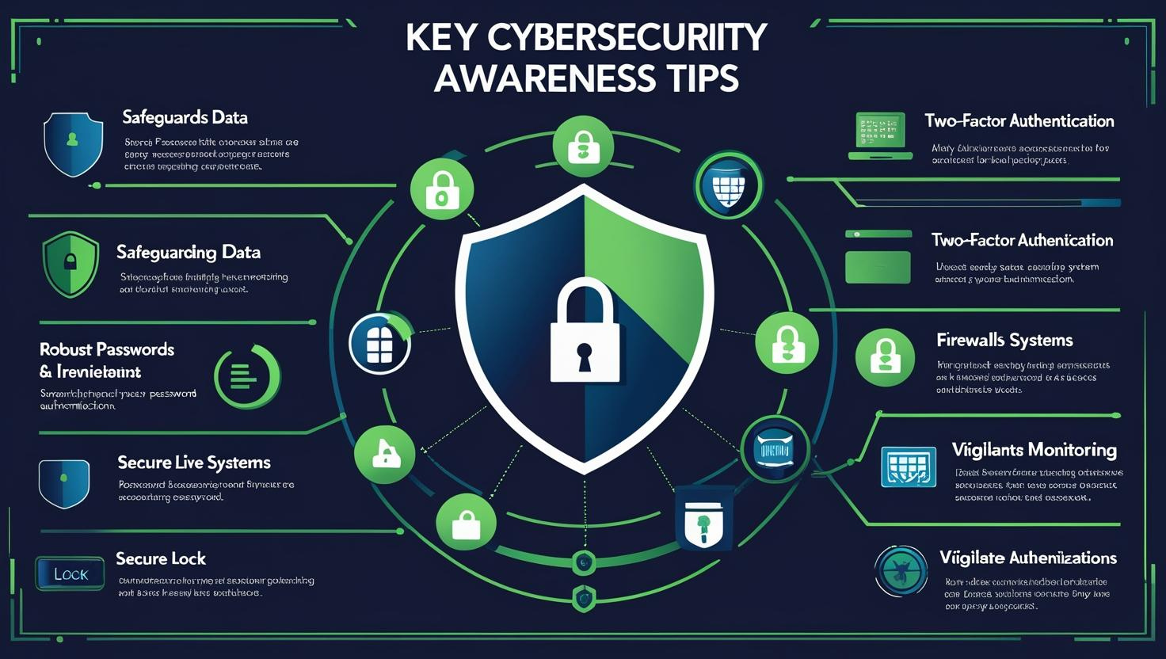

Slide 9

Prevention Best Practices
Always verify sender identity before clicking links.
Use strong, unique passwords and enable multi-factor authentication.
Keep software updated to patch vulnerabilities.
Report any suspicious messages to IT or security teams.

Slide 10
Interactive Knowledge Check
Example | Message/Scenario | Phishing or Safe?
1 | Email from “Bank@secure-mail.com” asking to reset your password via a link | ❓
2 | SMS: “Congratulations! You’ve won a prize! Click here to claim.” | ❓
3 | Email from company HR about an event, no links/attachments | ❓
"Put your knowledge to the test — spot the phishing traps before they catch you!"

Slide 11
Final tips & takeaways
Think before you click.
Verify sender & links.
Use MFA for safety.
Practice makes perfect
Continue improving
Join awareness sessions.
Update security tools.
Share safety tips with others.

Slide 12
THANK YOU
Maryam Noor
0318-0885724
mn2016410@gmail.com

